Slide 2
The mission of the DC Commission on the Arts and Humanities is to provide
• grants
• programs
• and educational activities
that encourage diverse artistic expressions and learning opportunities so that all District of Columbia residents and visitors can experience the rich culture of our city.

Slide 3
Grants Department
Staff Member | Title | Grant Program
Moshe Adams | Director of Grants
David Markey Ariel Wilson | Arts Education Coordinator Arts Education Program Associate | Arts Education Program Larry Neal Awards Poetry Out Loud
JR Russ | Grant Manager | Artist Fellowship Program - Performing & Literary Arts
Keona Pearson | Grant Manager | Public Art Building Communities
Regan Spurlock | Grant Manager | Artist Fellowship Program - Visual & Media Arts City Arts Projects – Individuals Sister Cities International Arts Grant
Steven Mazzola | Grants Program Manager | Cultural Facilities Projects Grants In Aid UPSTART
Tierra Buggs | Grant Manager | City Arts Projects – Organizations East of the River

Slide 4
Grant Programs
Grant Program | Maximum Award | Required Match
Arts Education Program (AEP) | $50,000 – Organizations | Organizations – 1:1
Artist Fellowship Program (AFP) | $10,000 – Individuals | None
City Arts Projects (CAP) – Organizations | $30,000 – $50,000 | Organizations – 1:1
City Arts Projects (CAP) – Individuals | $10,000 – Individuals | Individuals – None
Cultural Facilities Projects (CFP) | $200,000 – Organizations | Organizations – 1:1
East of the River (EOR) | $40,000 – Organizations | None
Grants-In-Aid (GIA) | $250,000 – Organizations | Organizations – 1:1
Public Art Building Communities (PABC) | $50,000 – Individuals $100,000 – Organizations | Individuals – None Organizations – 1:1
Sister Cities International Arts Grant (SCIAG) | $20,000 – Individuals $20,000 – Organizations | Individuals – None Organizations – 1:1
UPSTART (UPS) | $100,000 – Organizations | Up to 30% of total award

Slide 5
Application deadlines
GRANT PROGRAM & DESCRIPTION | DEADLINE
City Arts Projects (CAP) – Less than $100,000 | Wednesday, May 7, 2014
City Arts Projects (CAP) - $100,000-$199,000 | Wednesday, May 7, 2014
City Arts Projects (CAP) - $200,000 and above | Wednesday, May 7, 2014
City Arts Projects (CAP) – Individuals | Wednesday, May 7, 2014
Artist Fellowship Program (AFP) | Friday, May 9, 2014
Grants-In-Aid (GIA) | Friday, May 9, 2014
Cultural Facilities Projects (CFP) | Monday, May 12, 2014
East of the River (EOR) | Monday, May 12, 2014
Arts Education Program (AEP) | Wednesday, May 14, 2014
Sister Cities International Arts Grant (SCIAG) | Friday, May 16, 2014
UPSTART (UPS) | Friday, May 16, 2014
Public Art Building Communities (PABC) | Friday, July 25, 2014 and Friday, October 17, 2014

Slide 6
DCCAH GRANTS STRUCTURE
DCCAH offers two types of grants:
General Operating Support
Project Based Grants.
General Operating Support Grants:
Fund costs associated with the continued functioning of an individual or organization. This can include overhead costs, staff salaries, programmatic costs, and marketing plans.
General Operating Support Programs:
Artist Fellowship Program (Individual Artists)
Grants-In-Aid (Organizations)

Slide 7
DCCAH GRANTS STRUCTURE
General Operating Support Program Goals:
Provide access to high-quality arts and humanities experiences for all District of Columbia residents;
Stimulate the creative economy through investments in local arts organizations and artists; and
Ensure sustainability for arts and humanities organizations so that they may continue to contribute to the District of Columbia’s diverse cultural landscape.
Examples of allowable costs included in General Operating Support Grants:
Salaries;
Artistic Expenses;
Overhead and maintenance;
Equipment, materials and supplies directly related to expanding access to artistic programming, including capital expenses and technological resources;
Consultants; and
Travel directly related to the cost of producing arts programming in the District of Columbia.

Slide 8
DCCAH GRANTS STRUCTURE
Project Based Grants: Provide support for individuals and organizations to execute projects that promote arts and humanities activities to a diverse range of communities within the District of Columbia. DCCAH encourages small, medium and large projects that have a city-wide impact, as well as those that represent community-based projects that are based on geographic location, common interests or a shared identity.
Project Based Grants
Arts Education Program (Organizations)
City Arts Projects (Organizations)
Cultural Facilities Projects (Organizations)
East of the River Grant (Organizations)
Public Art Building Communities (Individuals & Organizations)
Sister Cities International Grant (Individuals & Organizations)
UPSTART (Organizations)

Slide 9
DCCAH GRANTS STRUCTURE
Project Based Grants Program Goals:
Provide access to high-quality arts and humanities experiences for all District of Columbia residents;
Increase quality of life by supporting a vibrant community identity through the arts and humanities; and
Stimulate the creative economy through investments in local artists and arts organizations.
Examples of allowable costs included in Project Based Grants:
Artistic personnel;
Artists / consultants;
Space rental and fees;
Travel and transportation directly related to project implementation; and
Equipment purchases that equal up to 25% of the grant award, which are directly related to project implementation; and
Overhead, maintenance and administration not exceeding 35% of the grant and match.

Slide 10
Eligibility Requirements
Organizations may apply if they meet all of the following eligibility requirements:
Nonprofit, 501(c)(3) as well as incorporated in DC;
Federal and DC tax exempt status in good standing;
Principal offices located in DC. PO Boxes are not permitted;
Commitment to provide arts and humanities programs to DC;
In good standing with DCCAH;
Ineligible organizational applicants:
Fiscal agents are ineligible to apply
Colleges, universities, service organizations, foreign governments, other DC government agencies, and DC Public Schools.

Slide 11
Eligibility Requirements Cont.
Individuals may apply if they meet all of the following eligibility requirements. Individuals must:
Be artists or arts professionals (e.g., presenters, producers and educators), aged 18 or older;
For City Art Projects, be legal DC residents for at least one year prior to the application deadline;
For Artist Fellowship Program, be legal DC residents for at least two years prior to the application deadline;
Must maintain residency during the entire grant period;
Have a permanent DC address, as listed on government issued identification or tax returns. PO Boxes may not be used as a primary address;
Be in good standing with DCCAH; and
Not use fiscal agents.

Slide 12
Application Process
DCCAH uses an online grant application portal, which is accessible from the DCCAH website: www.dcarts.dc.gov
All applicants must submit applications online by 6:00 PM on the deadline date of each program.
DCCAH will not accept mailed, emailed or hand-delivered copies of grant applications.

Slide 13
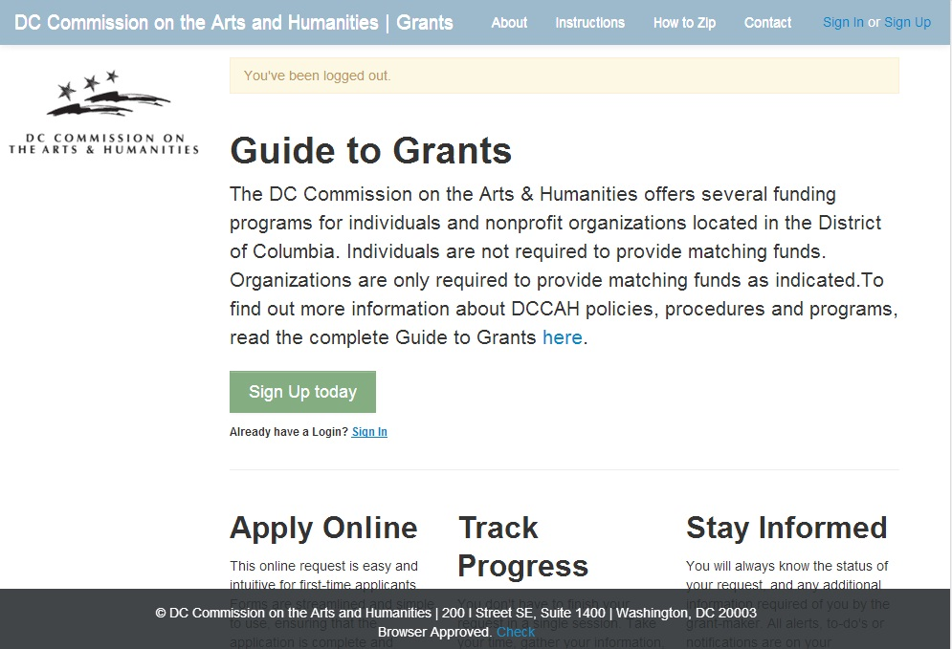
DCCAH Grant Portal

Slide 14
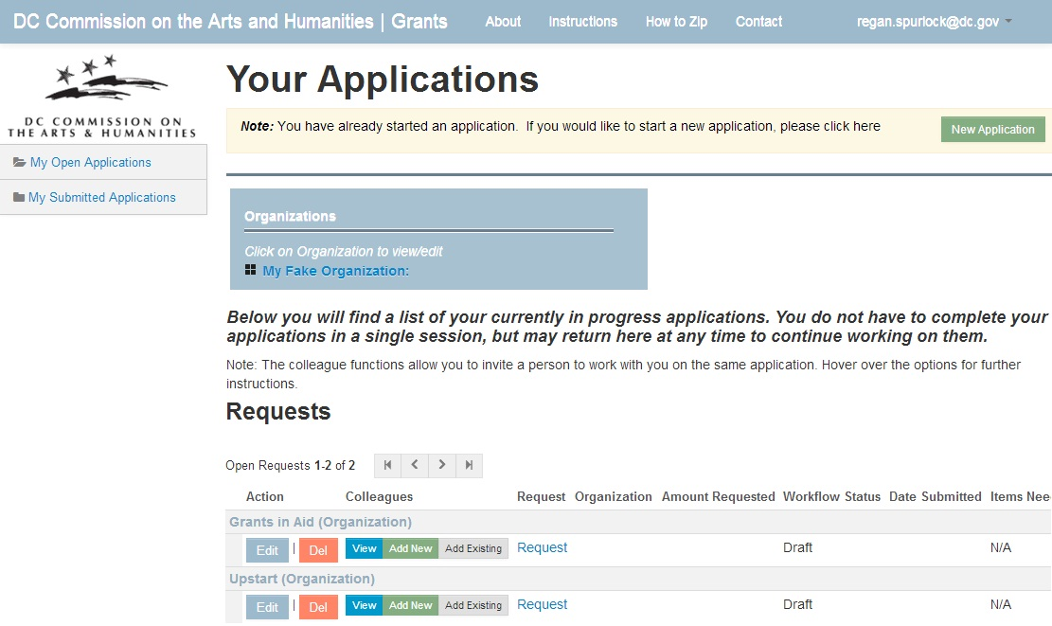
DCCAH Grant Portal

Slide 15
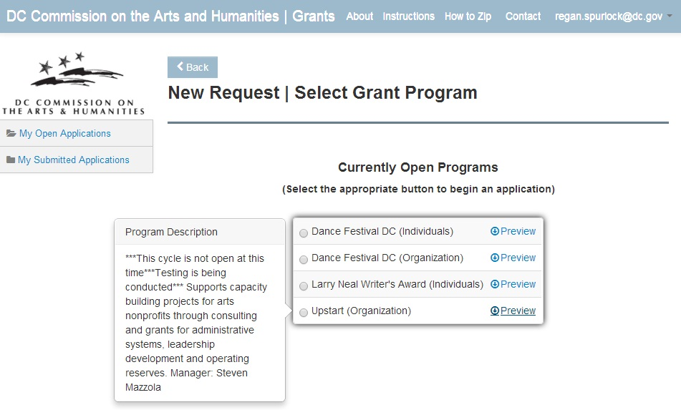
DCCAH Grant Portal

Slide 16
Work Samples and Artistic Content
The DCCAH values and emphasizes artistic excellence in all grant programs within all disciplines.
Artist content is one of several criteria on which an application is reviewed.
Artistic content is demonstrated to the Advisory Review Panel through the applicant’s:
Work sample;
Support materials;
Résumé(s) of key personnel
Assessment and Evaluation

Slide 17
Work Samples and Artistic Content
1. Work Sample
The work sample caries the most weight.
Must demonstrate the clearest depiction of the applicant’s best work(s) of art.
Panelists must be able to assess the skill level of the artist(s) involved in grant related activities.
Applicants must pay close attention to the content of work sample submissions.
Review the “Work Sample Requirements”, which describe what to submit within a work sample.

Slide 18
Work Samples and Artistic Content
All applicants must submit an artistic work sample(s).
Work samples must be no more than two years old. Submitting older work samples will make the application ineligible for funding consideration.
For much more detailed information on Work Samples, read Addendum A: Work Samples, which is located in the guidelines.

Slide 19
Work Samples and Artistic Content
2. Support Materials
Support materials are documents that strengthen the application and provide additional information that directly relates to the grant request.
Support materials do not take the place of a work sample!
They do, however, reinforce the quality of the applicant’s artistic disciplines(s).
Some examples of support materials are:
Theater/exhibition reviews;
Letters of recommendation;
Certificates;
Sample lesson plans;
Assessments and evaluations; and
Awards.

Slide 20
Work Samples and Artistic Content
3. Résumé(s) of key personnel
The Advisory Review Panel determines the artistic content of each application by reviewing the résumés of the key artists, administrators, and facilitators involved in the grant activities.
The professionals involved in the project determine the capacity of the project and ability for the applicant to effectively create an excellent artistic product and/or experience.
Their backgrounds as artists and administrators should be relevant to the project and clearly demonstrated through their professional résumés.

Slide 21
Work Samples and Artistic Content
4. Assessment and Evaluation
Purpose of Assessment & Evaluation
To determine the efficacy of a program – as articulated in the program goals and as required for grant reporting.
To provide evidence to support changes in order to improve the program and its delivery.
Types of Assessment & Evaluation
Qualitative Assessment is often subjective in approach and narrative in nature.
Quantitative Assessment provides empirical data that demonstrates growth in the knowledge, skills, and understandings of the participants.
Assessment & Evaluation Design
There are many ways to assess and evaluate programming including: needs assessments, pre- and post-testing, and formative, observational, and summative assessments that utilize mixed method approaches such as portfolio assessment.

Slide 22
Mandatory Documents for Organizations
May include:
Work Sample(s) Support Material
Resume(s) of key personnel
Signed W-9
IRS Letter of Determination
DC Certificate of Incorporation
Board list
2013 CDP Funders Report

Slide 23
Mandatory Documents for Individuals
May include:
Work Sample(s) Support Material
Resume(s) of key personnel
Signed W-9

Slide 24
Review Process
Applicant submits application
DCCAH distributes to volunteer panel
Panel scores application & makes recommendations
Commission board makes funding determination
Applications are reviewed according to the following criteria:
Artistic Content
District Impact and Engagement
Capacity and Sustainability
Overall

Slide 25
Review Criteria
Artistic Content
High standards of artistic excellence
Personnel with demonstrated arts experience
Commitment to hiring DC-based artists
Effective evaluation methods
District Impact & Engagement
Targets DC residents
Appropriate marketing methods & partnerships
Accessibility of proposed activities

Slide 26
Capacity and Sustainability
Review Criteria
Proper oversight with well-rounded expertise
Realistic planning
Ability to implement the project
For festivals, required permits and permissions
Financial Capacity - realistic/accurate budget
Ability to match funds, where applicable
Overall Application
Application provides a clear explanation
Grant request and outcomes support the program goals

Slide 27
Notifications and Payments
Applicants will be notified in writing after October 1, 2014. This notification may consist of:
grant package
letter of ineligibility
letter of denial
The original copy of the grant agreement and all associated documents must be completed and returned to DCCAH.
Please note that the date of payment disbursement is subject to change depending on the availability of funds.

Slide 28
Performance Monitoring
All grant recipients are subject to monitoring requirements in the City-Wide Grants Manual and Sourcebook.
All activities funded by DCCAH will be monitored by staff through:
Interim reports
Site visits (including performances and presentations)
Email correspondence and phone calls
All grantees must complete a final report by October 15, 2015.

Slide 29
How to find more information
Visit our website: www.dcarts.dc.gov
Select “Apply for Grants” from the menu
Select “Getting Started”
For more information about the DCCAH grant portal, there are Step by Step Instructions in the Guide to Grants and on our website.

Slide 30
Questions?
Office Hours Monday-Friday, 9 am to 5:30 pm
200 I (Eye) Street SE, Suite 1400 Washington, DC 20003 www.dcarts.dc.gov
Phone: (202) 724-5613 Fax: (202) 727-4135 TTY: (202) 724-4493
The Mission of DCCAH is to provide
grants, programs and education activities that encourage diverse artistic expressions and learning opportunities so that all District of Columbia residents and visitors can experience the rich culture of our city.

