Slide 1
D.C. Labor Market Indicators: January 2015 - January 2024
Dr. Unique Morris-Hughes, Director
Victor Robertson, Chief Strategist for Education and Workforce Innovation
Dr. Rebati Mendali, Chief Economist/Associate Director
Prepared by the Office of Labor Market Research and Performance

Slide 2
Highlights
From January 2015 to January 2024:
The unemployment rate in DC decreased by 2.3 percentage points from 7.4% to 5.1%;
Unemployment rate in Ward 7 and Ward 8 decreased by 4.7 percentage points (12.9% to 8.2%) and 5.6 percentage points (16.1% to 10.5%) respectively;
Total number of DC residents that are employed increased by 25,900;
Total number of jobs in DC increased by 11,100;
Initial monthly unemployment insurance benefits claimants increased by 5.3%;
Total number of unemployed DC residents decreased by 8,100 people;
The average weekly median duration of unemployment for Black and African American decreased by 16.7 weeks;
The private sector total number of payroll jobs in the District increased by 12,900 jobs (2.52% increase);
Professional and Business Services has the highest employment increase among industries with employment increased by 13,800;
The highest in-demand occupation is Software Developers with an average monthly opening of 881 jobs;
The highest in-demand occupation requiring less than a bachelor’s degree is Secretaries and Administrative Assistants, Except Legal Medical & Executive with an average monthly opening of 358 jobs.

Slide 7
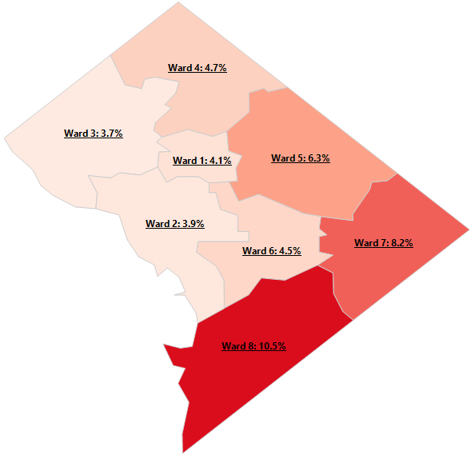
Unemployment Rate by Ward: January 2024
Ward data have been updated to reflect new Ward boundaries.

Slide 17
This workforce product was funded by a grant awarded by the U.S. Department of Labor’s Employment and Training Administration. The product was created by the recipient and does not necessarily reflect the official position of the U.S. Department of Labor. The U.S. Department of Labor makes no guarantees, warranties, or assurances of any kind, express or implied, with respect to such information, including any information on linked sites and including, but not limited to, accuracy of the information or its completeness, timeliness, usefulness, adequacy, continued availability, or ownership. This product is copyrighted by the institution that created it. Internal use by an organization and/or personal use by an individual for non-commercial purposes is permissible. All other uses require the prior authorization of the copyright owner.

Slide 18
Contact Information
Pablo Venturino, Program Analysis Officer
Opeyemi Fasakin, Labor Economist
Thomas Tsegaye, Labor Economist
Data Request: app.smartsheet.com/b/form/6558fe3e5bee43ceb0238229b0c61224
Email: lmi.does@dc.gov
Phone: (202) 671-1633
Website: www.does.dc.gov
http://does.dc.gov/page/labor-statistics

