Slide 1
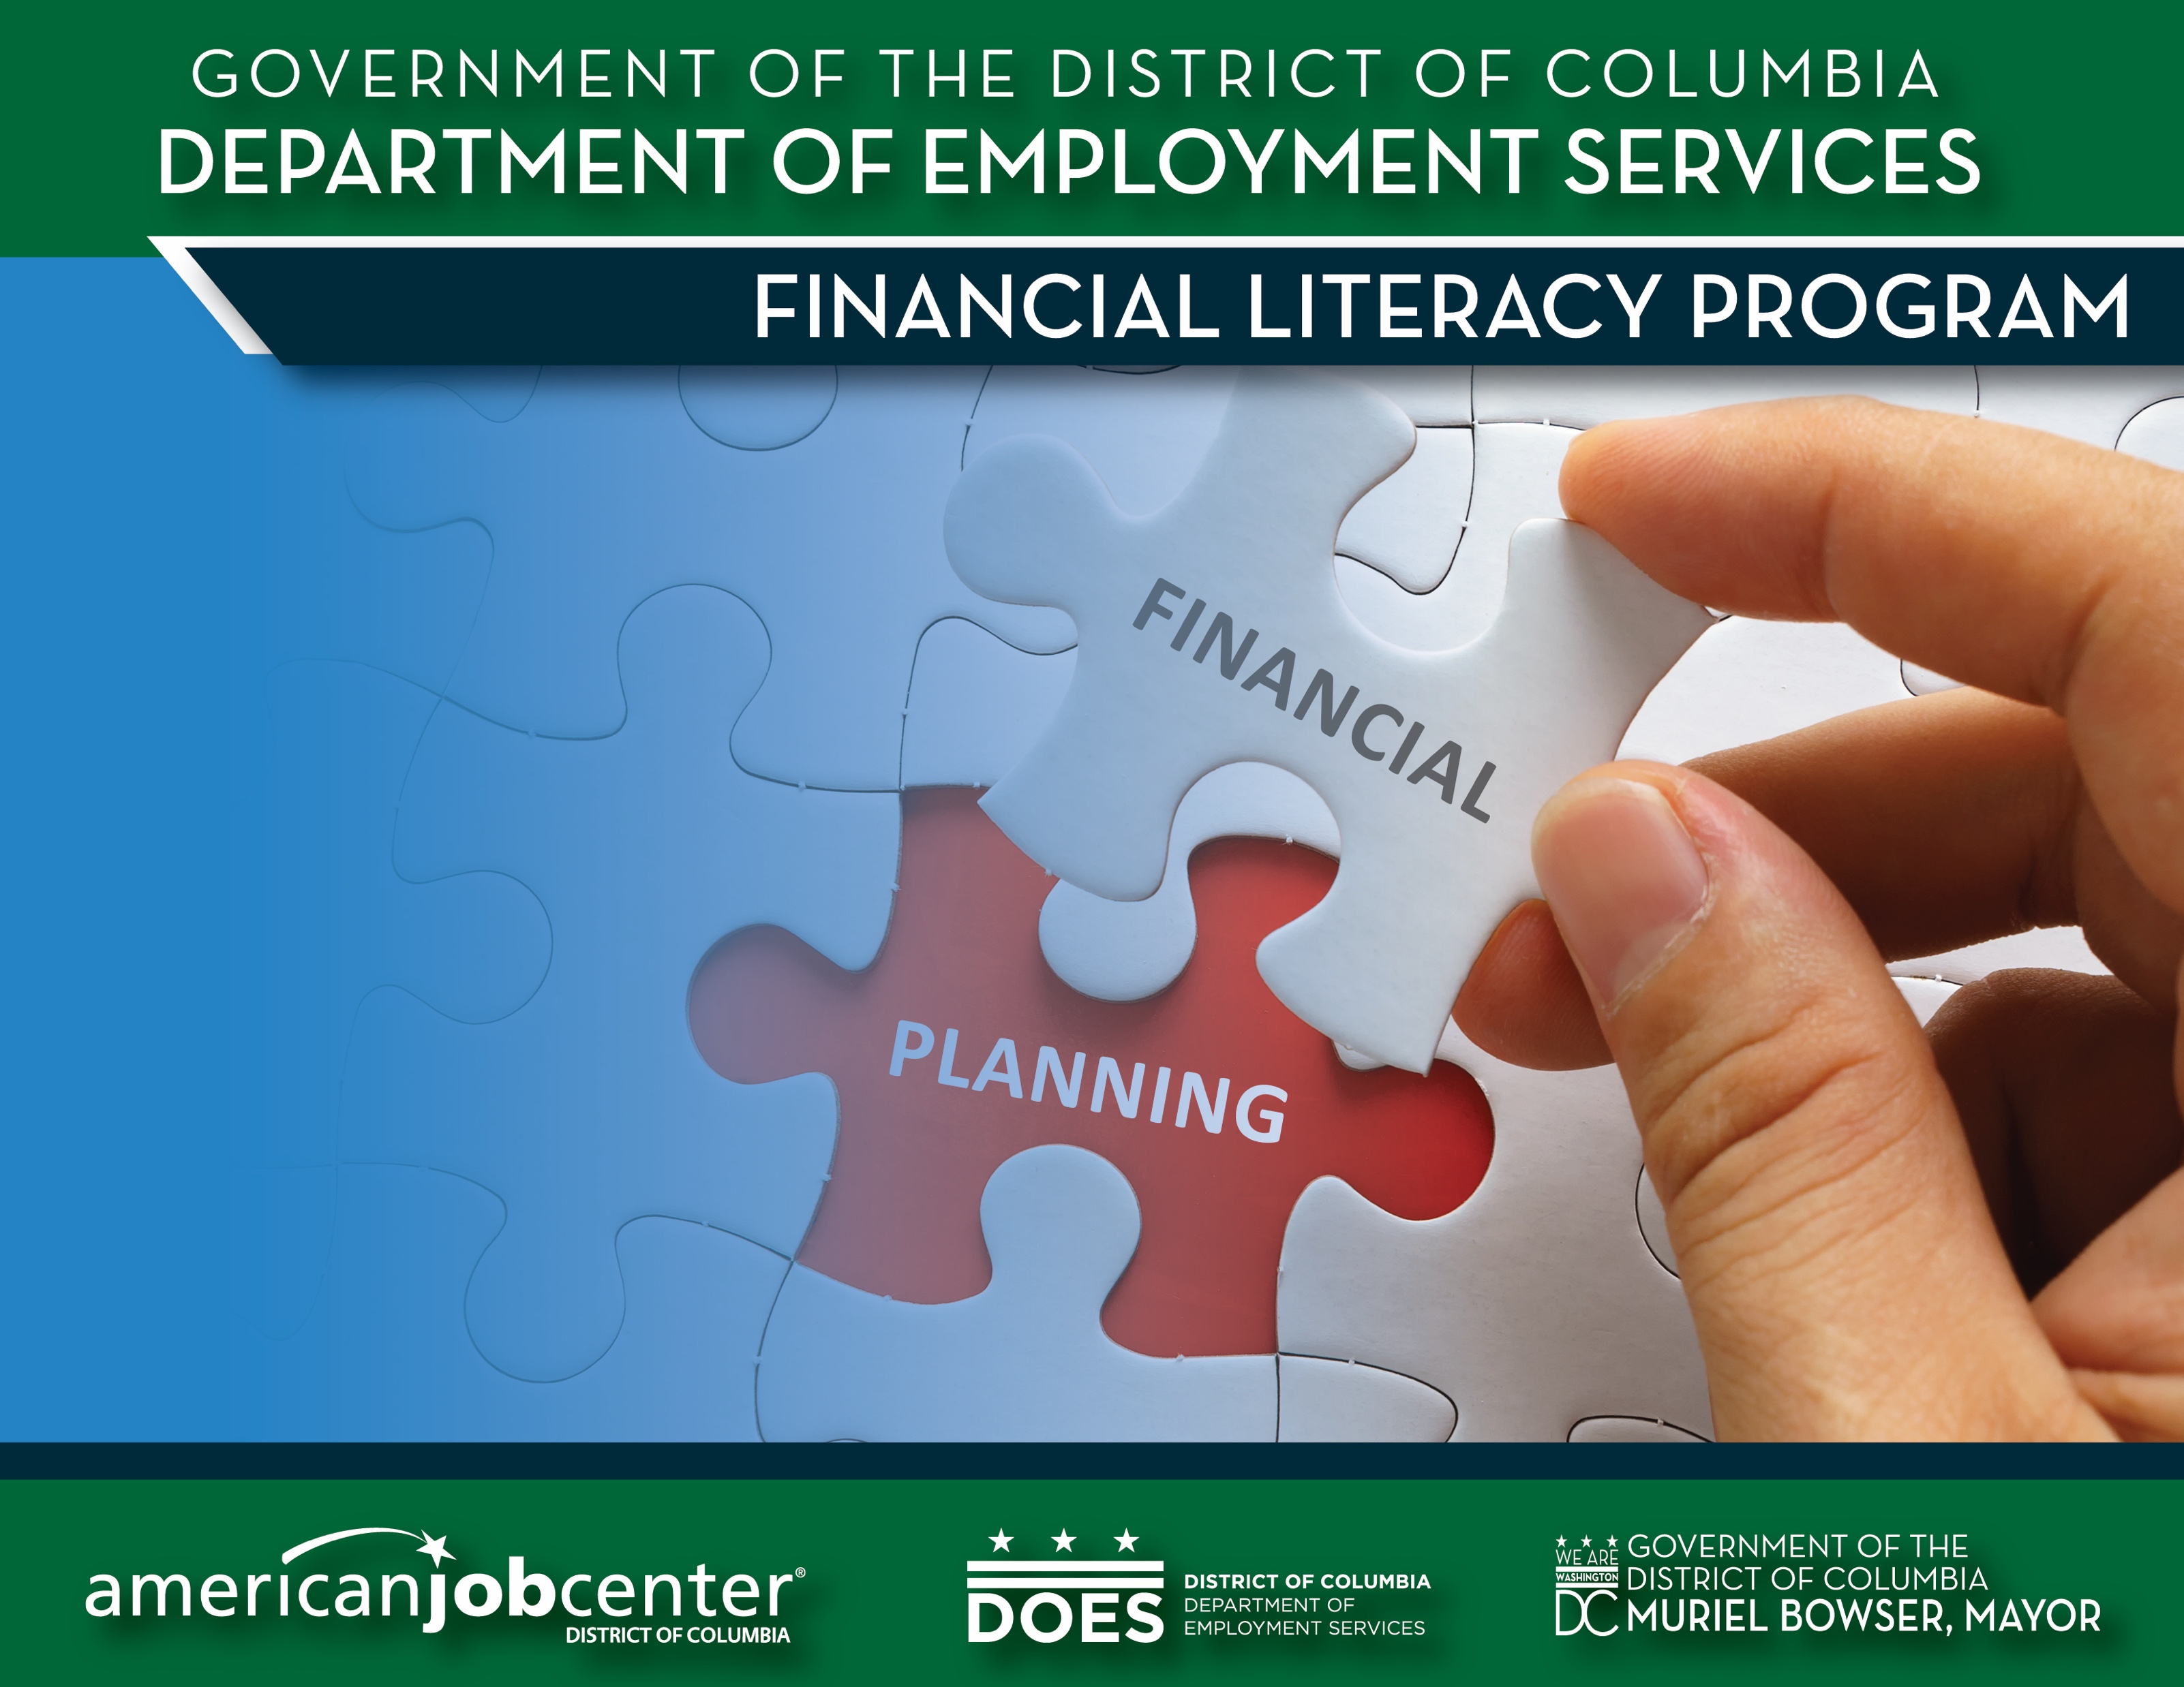

Slide 2
Financial Planning
More than budgeting
More than investing
Financial planning is a thinking process that helps achieve goals.
A blueprint or plan for managing all components of a person’s money.
Arranging to spend, save, and invest money to live comfortably, have financial security, and achieve goals.

Slide 3
Components of a Financial Plan
Goals
Net Worth Statement
Budget
Insurance Plan
Savings Plan
Investment Plan

Slide 4
Benefits of Having a Financial Plan
You have more money and financial security.
You have money set aside to achieve your goals.
You have less of a chance of
  going into debt you
  cannot handle.

Slide 5
How do I make a Financial Plan?
Determine your current financial situation.
  Make a list of items that relate to your finances:
  Savings/Investments
  Monthly Income
    (Job Earnings, Allowance, Gifts, Interest)
  Monthly Expenses
  Debts

Slide 6
How do I make a Financial Plan?
2. Develop your financial goals.
Consider your attitude toward money.
Ask yourself the following:
How do I determine if it is more important to spend money now, or save it for the future?
How do your personal values affect your financial decisions?

Slide 7
How do I make a Financial Plan?
3. Identify your options.
Continue the same course of action.
Expand the current situation.
Change the current situation.
Start something new.

Slide 8
How do I make a Financial Plan?
4. Evaluate your alternatives.
Consider the risks and consequences of each decision you make.
Be aware of all sources of financial information.
Evaluate consequences of choices, both good and bad.
Understand risks involved with choices.

Slide 9
How do I make a Financial Plan?
5. Create and use your financial plan of action.
Just DO it!

Slide 10
How do I make a Financial Plan?
6. Review and revise your plan.
As we get older, our circumstances, finances, needs, and wants will change, therefore, our financial plan must be flexible as well.

